Slide 1


RDA(NSW)-WHERE ARE WE GROWING?
Together or Apart
Jan Pike

Slide 2

...In the beginning…
Positives!
Growth = Grief or Elation
People
Horses
Time to volunteer

Slide 3

...Decades later….
Negatives!
Work commitments
  Less volunteers
  More pressure
Centres development
  Increased governance
Laws change
  more rules

Slide 4

...Still later….
Positives!
Development of RTO , SNC, CASP, Discipline Committees
New State Constitution
Negatives!
Limited connectivity
Slow acceptance of change
Lack of Networking

Slide 5
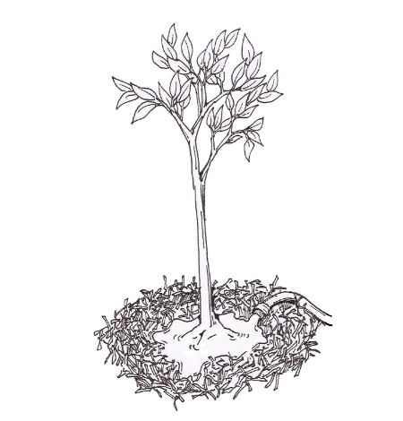
...Nowadays...
Outcomes
Members vs $$s
Too much stress
Growth slows
Communication difficulties

Slide 6
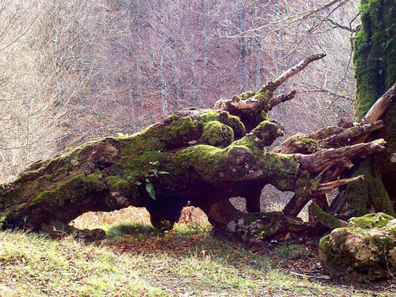
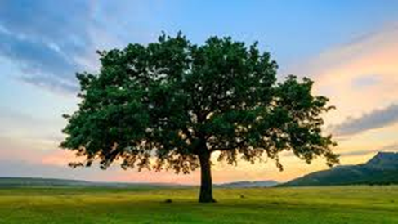
Our Future...
Our Choice...

