Slide 1

HAPPINESS & HARMONY
IN YOUR
CENTRE
BY
PUTTING “US”
INSTEAD OF “ME”

Slide 2

“US”&”ME”
When joined together make: “WE”
and together
“WE WILL” get the job done

Slide 3
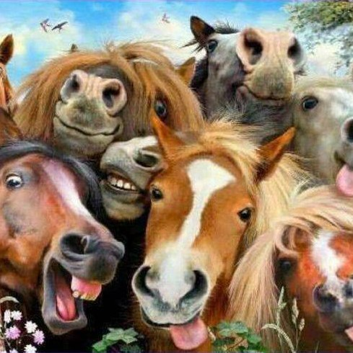
So how do you create Happiness and Harmony at your RDA Centre?

Slide 4
Listen to everyone
Committees are comprised of many individuals – all with different views and opinions.
Decisions will be the result of discussion and consultation
Address any questions

Slide 5
Keep everyone in the loop
Inform Volunteers about Committee Decisions
REMEMBER secrets only make for distrust, lead to misinformation being dispersed at your Centre and bad feelings result

Slide 6
WHO IS IN CHARGE at your RDA Centre?
Is it:
The President?
The Committee?
or is it the Coach?

Slide 7
NO ONE PERSON is in charge as we all play important RDA(NSW)roles
Your COMMITTEE MEMBERS are good volunteers. They have raised their hands to taking on special responsibilities within the ADMINISTRATION at your RDA Centre.
Your COACH is also a good volunteer that has raised their hand to doing the Coaching course to ensure safe pleasurable riding for our riders during a session.
REGIONAL REPRESENTATIVE agrees to liaise between your centre the region and the RDA(NSW) Board.

Slide 8
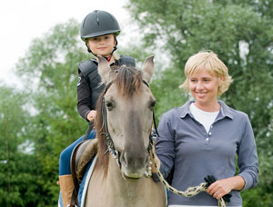
The session COACH is in
Charge of all aspects of that Riding session
But they not in charge of the centre. The session coach is considered the person in control &
is responsible for
everyone during a
riding session.

Slide 9

Is the TREASURER in Charge?
NO
The Treasurer accounts for all money collected and received
Issues receipts
Balances the finances
Keeps accurate Petty Cash records
Reports to the meetings

Slide 10

Is the SECRETARY in charge? NO
The Secretary ensures all the administration paperwork is in order and stored properly
Takes accurate meeting minutes and forwards to State Office promptly
Maintains WWCC
Prepares for Centre Audit for Regional Representative visit

Slide 11
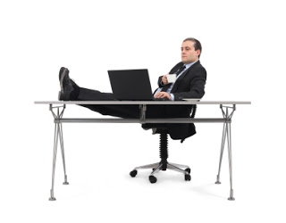
Is the President in charge? NO
MEETINGS
President Chairs meetings
President maintains order at the Meetings
Does not permit raised voices, insults and abusive language.

Slide 12
Answer:
NO-ONE IS IN SOLE CHARGE
THE RDA(NSW) Centre COMMITTEE
is in charge of the
Administration of the RDA Centre,
It is made up of the
ELECTED OFFICE BEARERS as well as each FINANCIAL MEMBER -
AND ALL HAVE EQUAL SAY.

Slide 13
The Committee of the Centre, subject to the Corporations Law, the Centre Constitution and to any resolution passed by the Centre in general meeting:
is to control and manage the affairs of the Centre; and
may exercise all such functions as may be exercised by the Centre, other than those functions that are required by this Constitution to be exercised by a general meeting of members of the Centre;
has power to perform all such acts and do all such things as appear to the Committee to be necessary or desirable for the proper management of the affairs of the Centre;
shall be responsible to the Association, including supplying to the Association: (i) periodic reports of activities of the Centre; and (ii) an annual report, including audited financial statements, of the Centre.

