Slide 1

ZOOM MEETINGS
Presentation

Slide 2
Introduction
Last year we introduced Zoom meetings and this presentation is to allow you all to view and understand what a
“ZOOM MEETING”
looks like when you are asked to attend

Slide 3
Convenience:
Use your own PC, Laptop or phone
Safety as No Travel involved
No Accommodation costs
Frequency – anytime, for as many times, for as long you want with no extra charges.
The money saved can be put to better use – Trainees attending workshops

Slide 4
An ISSUE you may find
If you have no voice receptor in your PC or Laptop – then also ring in with your phone. This way you can see who is speaking and what is going on as well as speak to everyone.
Or use speaker headphones

Slide 5

An email will be sent from your Host inviting you to join a Zoom Meeting
Join Zoom Meeting
https://zoom.us/j/XXXXXXXXXX
Where the X s are the Host’s ID Number.
This link should take you straight to the correct site

Slide 6
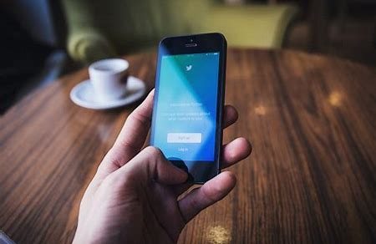
To use your phone
One tap mobile
+61871501149,,xxxxxxxxxx# Australia
+61280152088,,xxxxxxxxxx# Australia
Dial by your location
+61 8 7150 1149 Australia
+61 2 8015 2088 Australia
Meeting ID: xxx xxx xxxx
Find your local number: https://zoom.us/u/ab7q8XHfrj

Slide 7
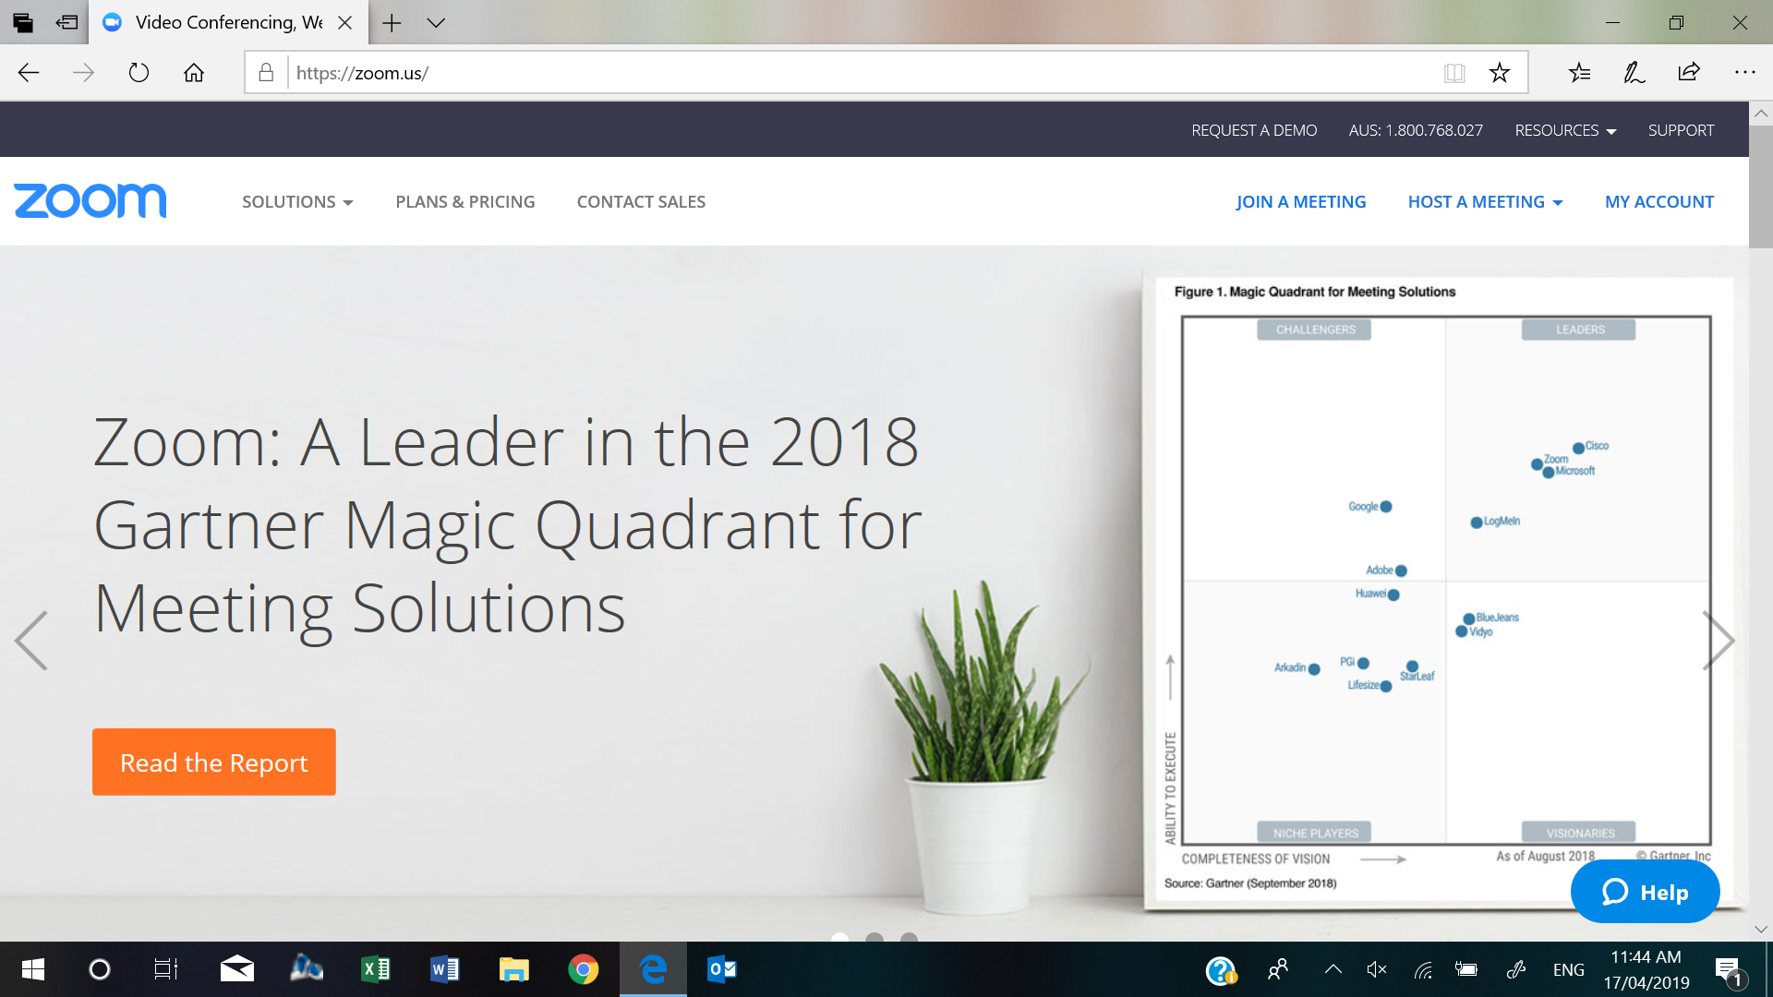
https://zoom.us/

Slide 8
Important
First time use allow 20 minutes to download the Zoom APP
When asked click: “save to computer”
Click both “Audio and Video” when asked

Slide 9

Manually
You Click onto – Join a Meeting

Slide 10
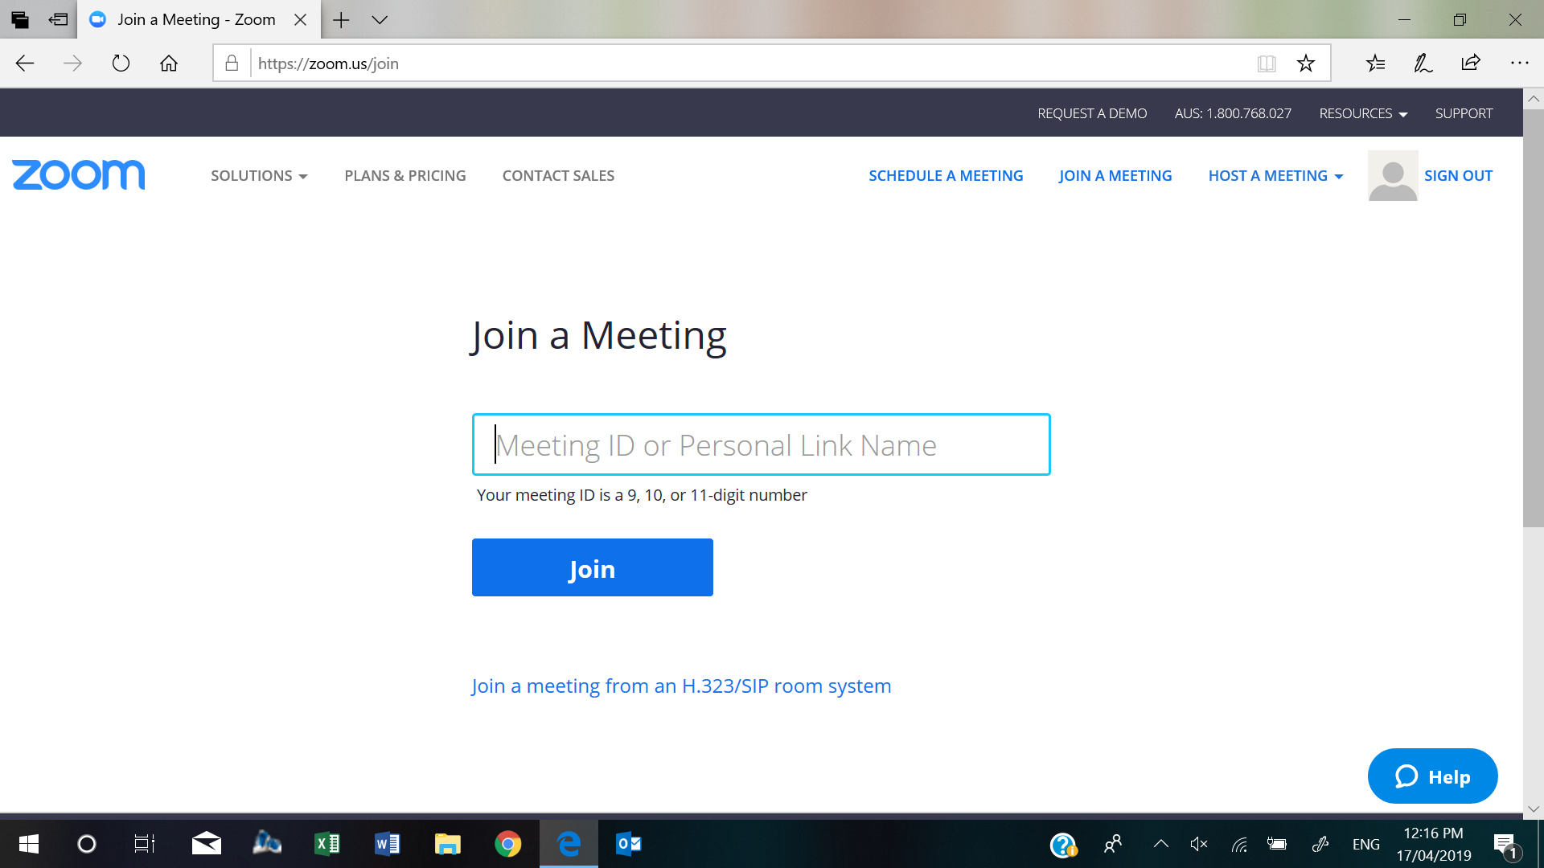
Type Meeting ID from email and click “join”

Slide 11
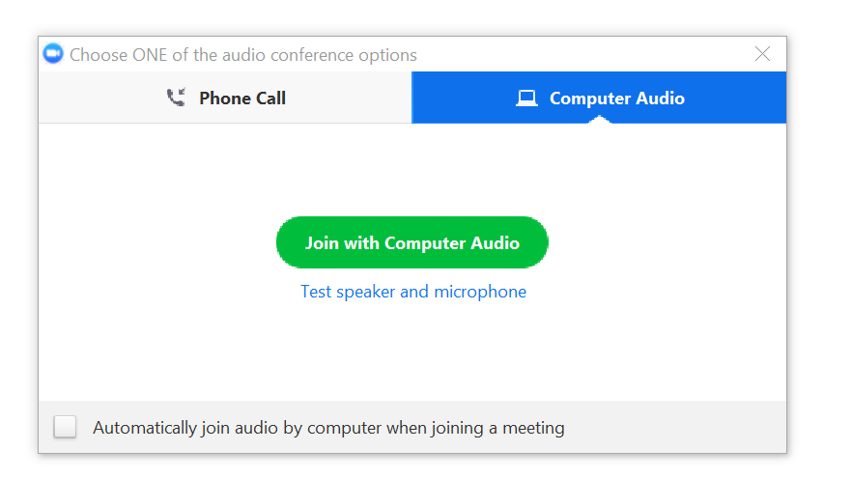
REMEMBER TO CLICK
– JOIN WITH COMPUTER AUDIO

Slide 12
The following is what a ZOOM MEETING will look like on your screen
.

Slide 13
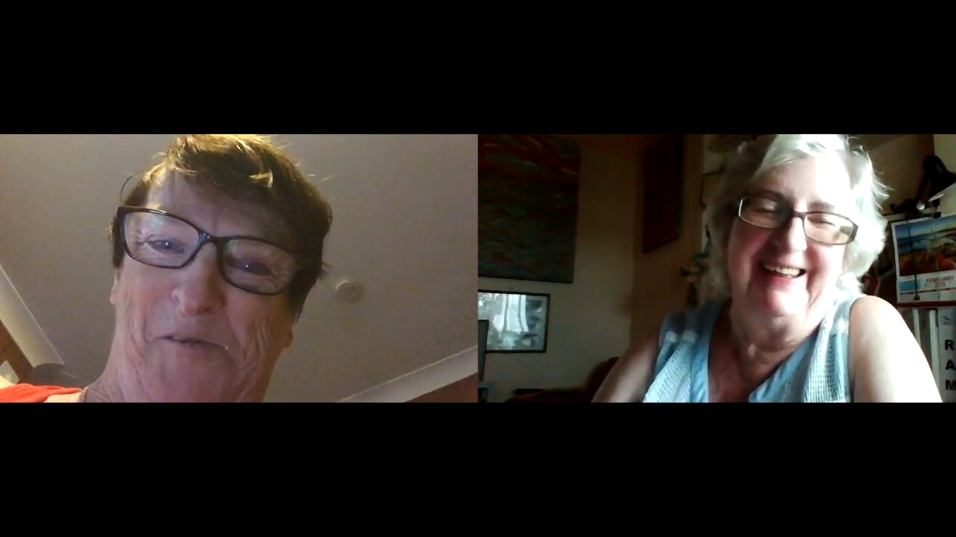
Two people

Slide 14
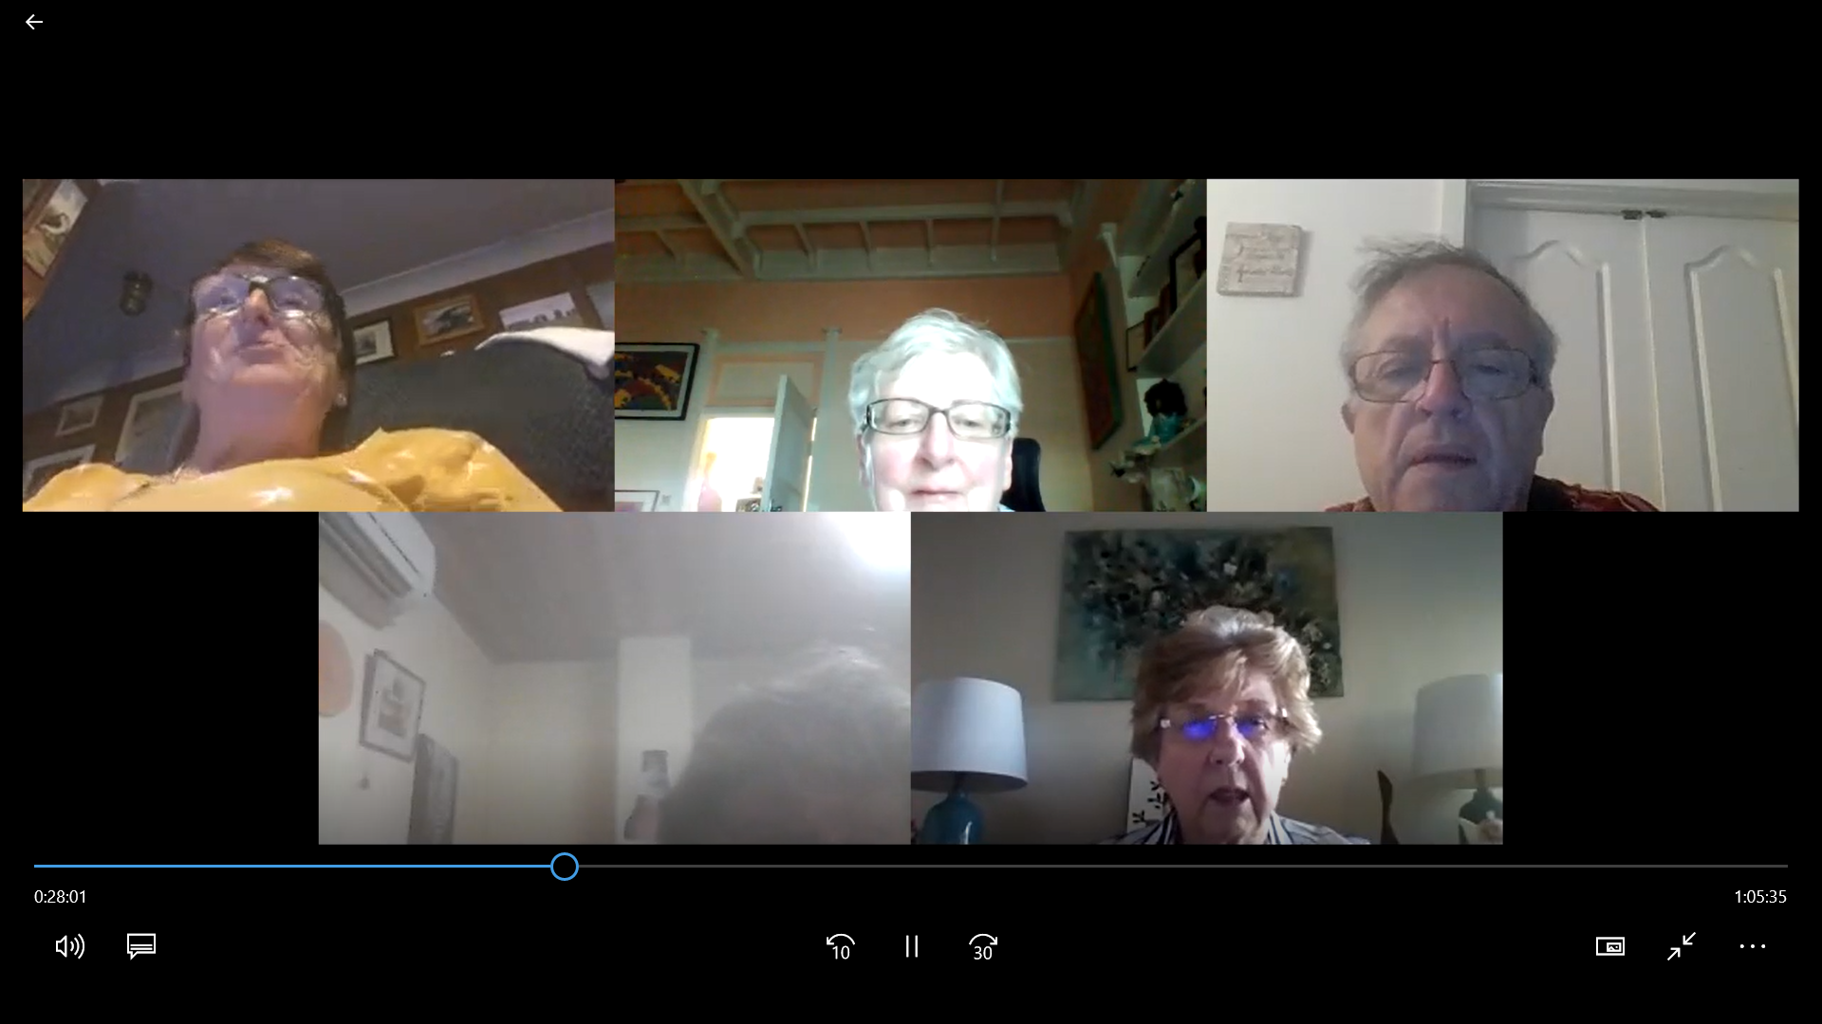
Or more people

Slide 15
Hover your mouse and some icons will appear at the bottom of the screen
You can turn on /off your Video and Audio using the appropriate icons – just click on the screen and the icons appear at the bottom of the screen. Click on “Participants” – and a side window will happen showing who is online. (Host uses this as they will see who is waiting to be admitted and needs to keep an eye on who leaves and wishes to return).
“Notes”– you can send private note to a person or all the attendees
“Whiteboard” – click and type here to send a msg /image etc for all to view.
The Hand icon is for you to “raise” your hand when you wish to speak

Slide 16
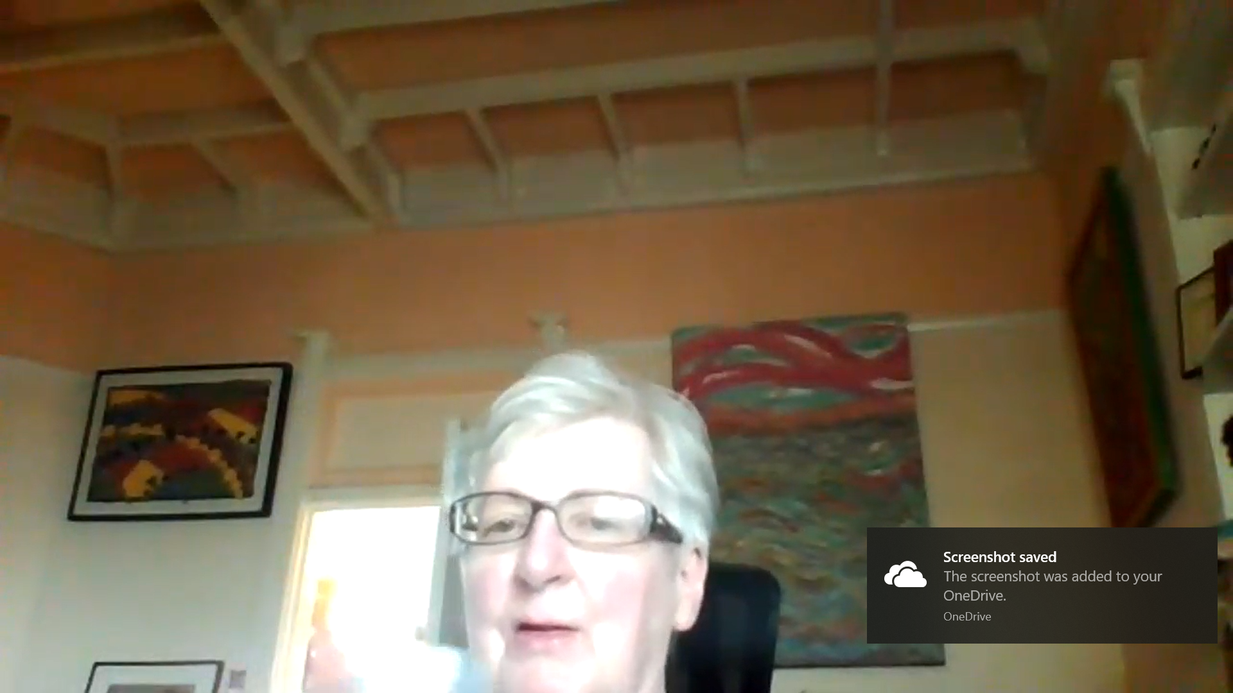
Or click on “speaker on full screen”
This is useful if there are many attendees

Slide 17
ZOOM MEETING ETIQUETTE
Start early – to download app or any new computer updates.
Deflect interruptions – have a sign ready saying “Video Call”
Don’t all type – the sound is amplified so use pen and paper. Minute taker should be the only one who types.
Use raised hand icon to ask to speak- speaking over one another is not only rude but will confuse everyone.
Identify yourself
Don’t eat – we may not smell your food but we can see you!
Have water at hand, but not alcohol
Control the background – excessive noise, clutter & people wandering past is distracting.

