Slide 1
THE Sport horse welfare
And social license to operate
“networking & communication ideas from”
An event held in South Australia February 2019
WHAT CAN we TAKE FROM THIS EVENT?

Slide 2

WHO WHAT WHY
Julie Fiedler - CEO of Horse SA had a vision to get horse people communicating
Julie wanted to open up communication and networking with members in the equine community to discuss some of the issues the industry faces
She is doing a masters in communications, so we were one of her assignments!
Julie’s idea was to get as many equestrian disciplines together and get them talking about horse welfare and the license to operate
Horse SA has extensive equine community support so from that data base plus some cold calling the event was circulated throughout Australia and New Zealand
Social media mostly, Facebook, was used to spread the word – and Facebook is free
There were attendees from Australia new Zealand and Hong Kong – the principal presenters being
Professor David Miller Martin burns -
Dr Andrew Mclean Julie Fiedler

Slide 3
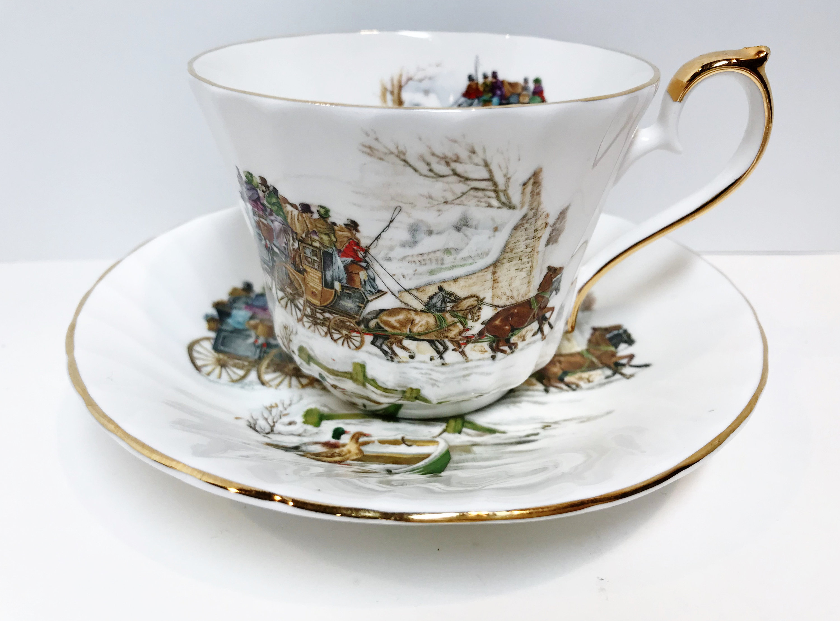
We all know that you can ask 10 horsey people the same question about horses and we get at least 50 different answers! Particularly with a group of mix equestrian activities. So there was potential for conflict.
The room was jammed full of horse people from racing, harness racing, endurance, pony club, showing, dressage, polo and the list went on and on – a bit like a packet of liquorice all sorts!
The room buzzed with excitement and tension for the first presentation
The first tea break was the ice breaker
People began networking and communicating
Through this the equestrian community began to grow

Slide 4
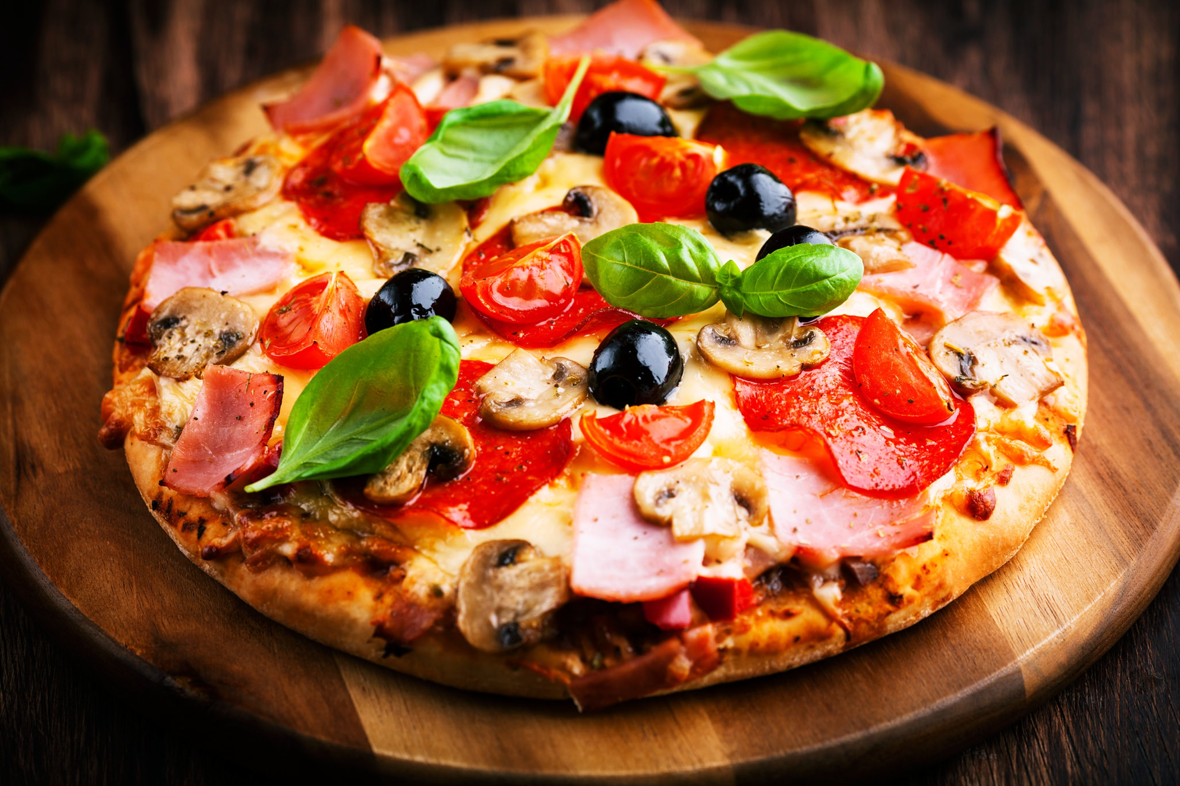
The food was delicious
No one seemed to notice
Pizza is my weakness – I was living proof you can eat and talk!
People were busy greeting OR introducing themselves
Small groups began to form
One could feel the tension easing and the excitement building
Sharing of each others involvement with horses was being discussed then business cards and phone numbers were being exchanged
All attendees were communicating and networking

Slide 5
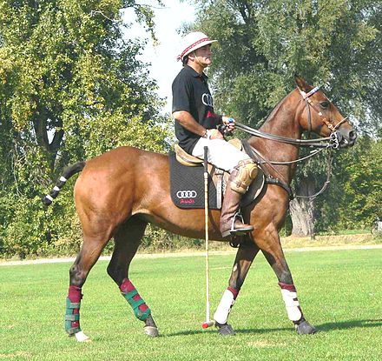
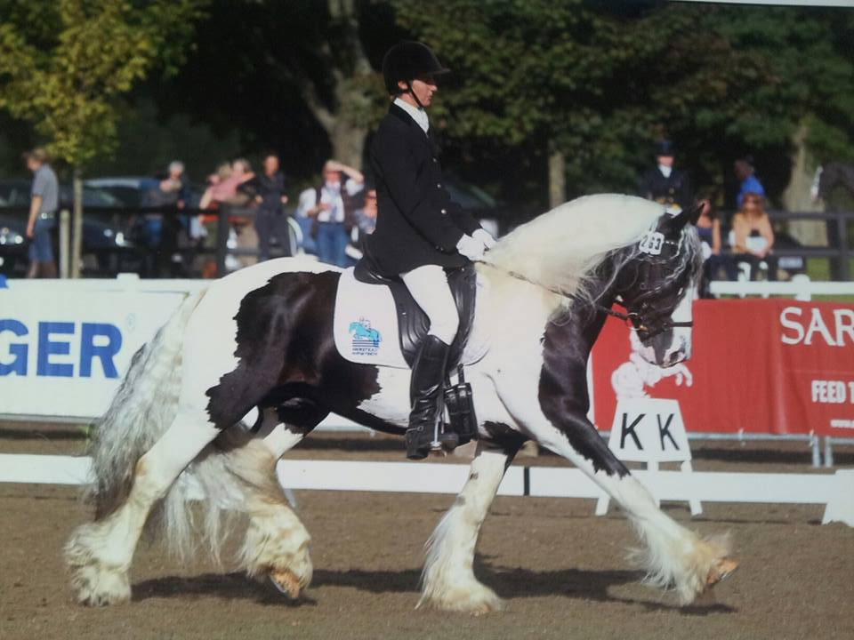
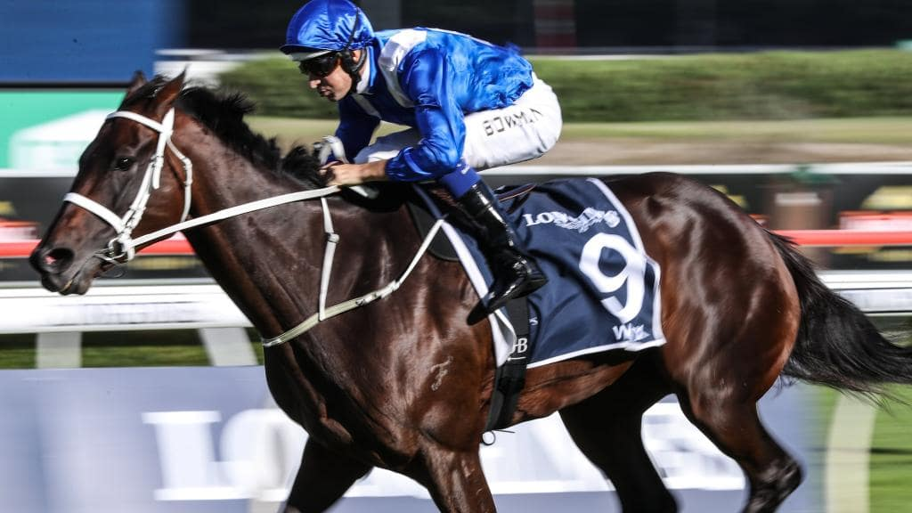
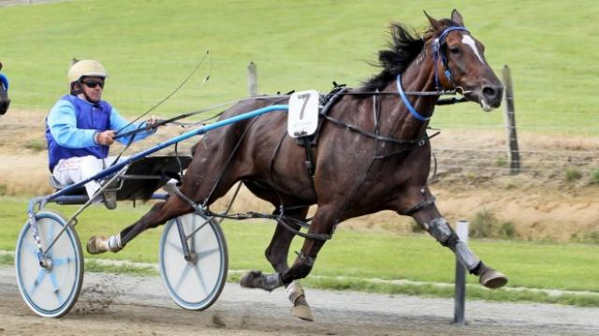

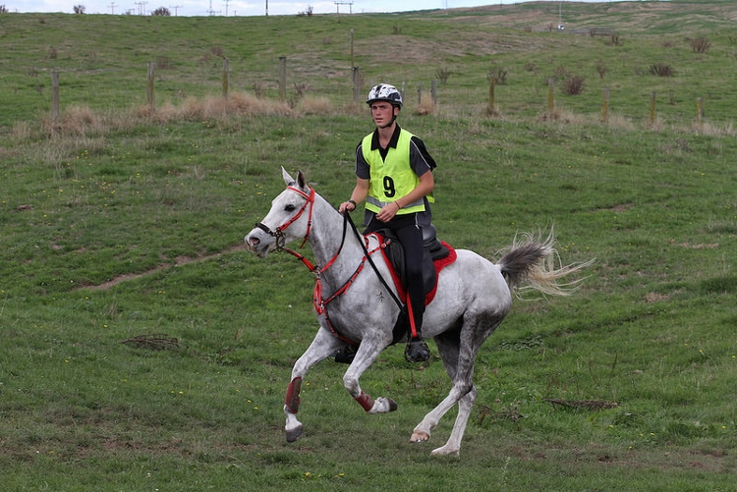
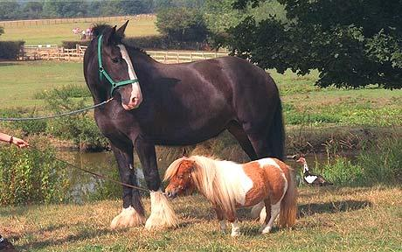
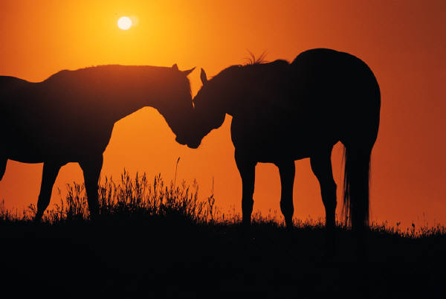
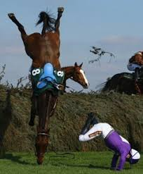
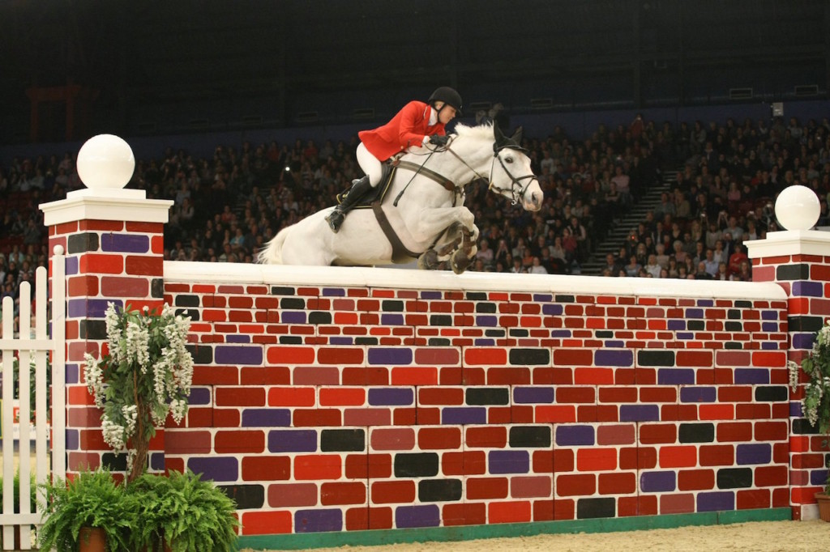
C
Let us communicate and network
Chat, find out about how other Centre’s operate
Let us ALL communicate and network
RDA needs all of us to flourish and grow
How can we communicate and network better?
Can we use Facebook better?
ommunication...

Slide 6
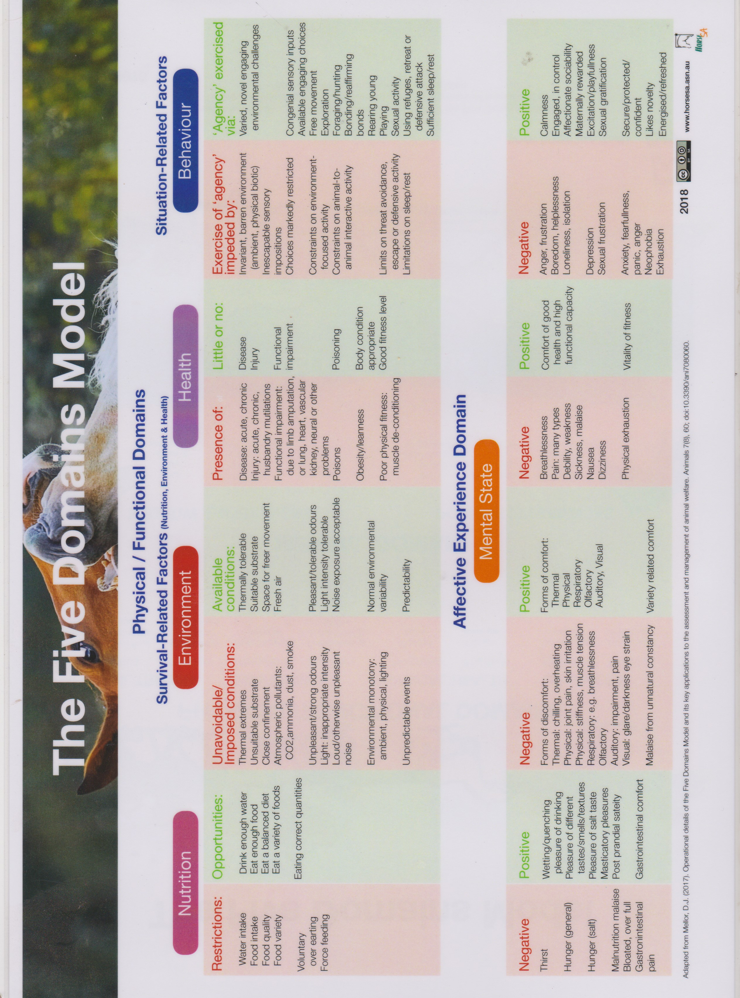

Slide 7
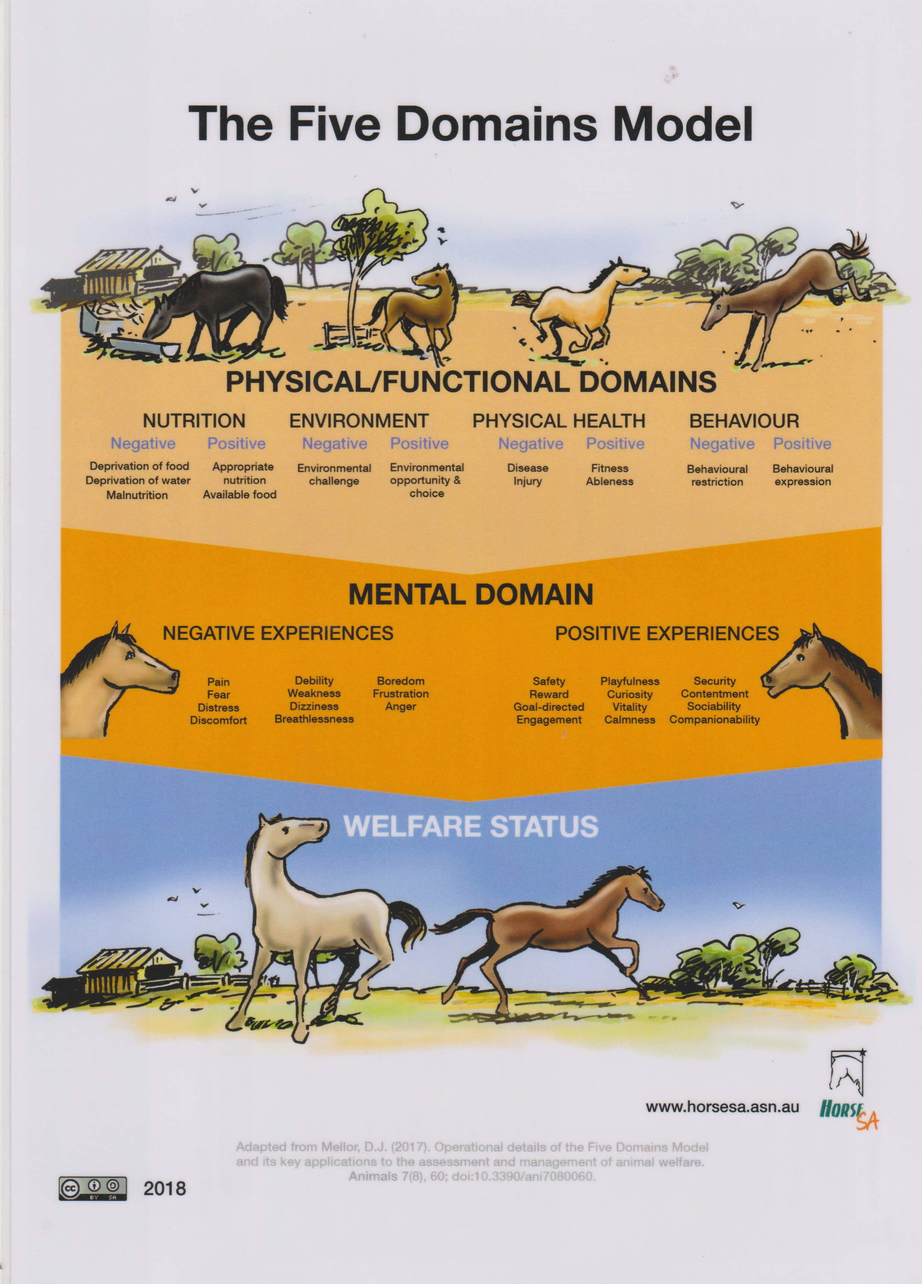

Slide 8
SUMMARY OF SOME OF THE PRESENTATIONS
THE FIVE DOMAINS MODEL was proposed by the event as a structured and constructive approach for continuous monitoring and welfare assessment of horses in sport.
Martin Burns (General Manager NZ Thoroughbred racing) gave an overview of how NZ use this evidence based approach. Minimum standards of policies should be higher than the legislation – legislation will catch up too soon.
Dr Andrew Mclean (Equitation Science International) reviewed the uptake of evidence based research and how it is used and assists horse sustainability.
Julie Feidler (CEO HorseSA) explained the importance of making welfare decisions in the company of the public and the ways good and bad public conversations can effect our use of horses.

