Slide 1

Riding for the Disabled Association (NSW)
Structure
and
Responsibilities

Slide 2

Why is this issue being addressed?
In order to understand the overall operations of RDA (NSW) it is important to know how RDA (NSW) is structured and the laws under which it operates.

Slide 3
Why is this issue being addressed?
Views which have been expressed over the years, including very recently, have varied between:
Why doesn’t the Board take a more active role in the management and control of our Centre;
and
This is our Centre and the Board should have nothing to do with our Centre and its operations
These are the “extreme” positions and, fortunately, very rare, but the results of such views account for a lot of the time of the Board.

Slide 4

What is RDA (NSW) made up of?
  The “head organisation” – RDA (NSW)
  Centres and Centre Members
  Volunteers/Employees

Slide 5
What is the structure of the “head organisation”?
RDA (NSW) is a company
Being a company, RDA (NSW) must comply with the Corporations Act and the Regulations under that Act
RDA (NSW) has a Constitution which, along with the company law, regulates the way that the company operates
RDA (NSW) is a “company limited by guarantee”
RDA (NSW) has “members” – each Centre is a “member” of RDA (NSW)

Slide 6
What does “limited by guarantee” mean?
The company does not issue shares and does not pay dividends
Each member of the company is required to pay a certain amount towards the liabilities of the company if the company goes into liquidation and is wound up
In the case of RDA (NSW), Centres are “members” of the company and are therefore liable to contribute towards those costs in the event of winding up
The Constitution of RDA (NSW) specifies that the amount of such contribution by each member is limited to the amount of unpaid annual affiliation fees (at present, a maximum of $110 if nothing has been paid) and (under commercial law) any amounts owing to the company – however, Centres are part of the company

Slide 7
What is the significance of RDA (NSW) being a “company”?
A company, amongst other things:
  At law, is treated as if it is a person
  Must comply with Government laws and regulations
  Can sue and can be sued
  Must have directors
  Operates through its directors and those authorised by directors
  Ultimate responsibility, at law, rests with the directors

Slide 8
Company law and RDA (NSW)
The Corporations Act 2001 and Regulations made under that Act control, or affect such things as:
Role, obligations, responsibilities and liabilities of directors.
Role of Constitution (if any) of a company.
Role and responsibilities of others associated with a company.

Slide 9
Company law and company constitution
Corporations Act 2019:
140 Effect of constitution and replaceable rules
(1) A company’s constitution (if any) and any replaceable rules that apply to the company have effect as a contract:
(a) between the company and each member; and
(b) between the company and each director and company secretary; and
(c) between a member and each other member;
under which each person agrees to observe and perform the constitution and rules so far as they apply to that person.

Slide 10
Company law and directors
Corporations Act 2019:
198A Powers of directors (replaceable rule—see section 135)
(1) The business of a company is to be managed by or under the direction of the directors.
(2) The directors may exercise all the powers of the company except any powers that this Act or the company’s constitution (if any) requires the company to exercise in general meeting.

Slide 11
Directors under Company Law
Duties of Directors are summarised in section 5.3 of the Corporations Act 2001 as including:
  to act in good faith
  to act in the best interests of the company
  to avoid conflicts between the interests of the company and the director’s interests
  to act honestly
  to exercise care and diligence
  to prevent the company trading while it is unable to pay its debts

Slide 12
Directors under Company Law
Section 5.3 of the Corporations Act 2001 also states:
A director who fails to perform their duties:
  may be guilty of a criminal offence with a penalty of $200,000 or imprisonment for up to 5 years, or both; and
  may contravene a civil penalty provision (and the Court may order the person to pay to the Commonwealth an amount of up to $200,000); and
  may be personally liable to compensate the company or others for any loss or damage they suffer; and
  may be prohibited from managing a company.
A director’s obligations may continue even after the company has been deregistered.

Slide 13
RDA (NSW) Constitution and directors
RDA (NSW) Constitution:
26.1. Powers and Duties of the Board of Directors
    Subject to the Act and this Constitution the business of the Company will be managed, and the powers of the Company will be exercised, by the Board of Directors. In particular, the Board of Directors as the controlling authority of the Company will be responsible for acting on all issues in accordance with the Objects and will operate for the collective benefit of the Company and Riding for people with disabilities and must:

Slide 14
RDA (NSW) Constitution and directors
26.1. Powers and Duties of the Board of Directors (continued)
(a) Govern Riding for people with disabilities in accordance with the Objects;
(b) Enact and give effect to the Company’s strategic direction of the time;
(c) By itself or on the advice of a committee appointed by the Board of Directors for this purpose, formulate, approve, issue, adopt, interpret and amend such Policies and Procedures for the proper advancement, management and administration of the Company, the advancement of the Objects and Riding for people with disabilities as the Board thinks is necessary or desirable;
(d) Review the Company’s performance in achieving its pre-determined aims, objectives and Policies and Procedures; and
(e) Manage the Company’s national responsibilities (if any).

Slide 15
What other laws and provisions apply?
Besides the Corporations Act 2001 and the Regulations under that Act, there are other laws and Government departments and instrumentalities that impact on RDA (NSW) and, therefore, its directors. These include, amongst others:
Australian Securities & Investments Commission | Child Protection (Working with Children) Act 2012
Australian Charities & Not for profit Commission | Privacy Act 1988 and Privacy Principles
Australian Taxation Office | NSW Sport Member Protection Policy
Liquor and Gaming NSW [for fundraising] | “Play by the Rules”
Work Health & Safety Act 2011 | National Disability Insurance Scheme Commission
Office of the Children’s Guardian | Employment laws
Charitable Fundraising Act 1991 | NSW Office of Sport

Slide 16
What is the status of Centres?
Under the current structure:
Centres are branches of RDA (NSW)
Centres are not separate from RDA (NSW)
Although they are self-managing, Centres operate under authority and delegation given to them by the directors of RDA (NSW)
Directors are, at law, responsible for oversighting of the operations of Centres, including setting policies and procedures
Centres are answerable to the directors if they do not comply with their obligations

Slide 17
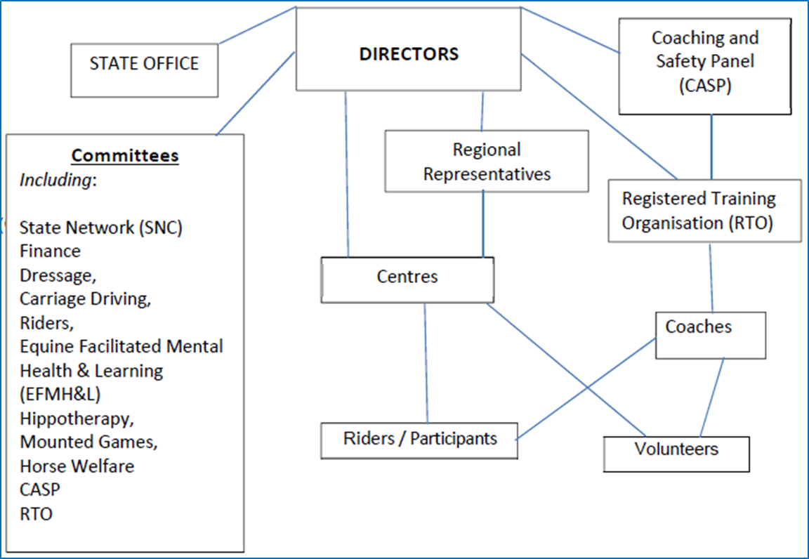
RDA (NSW) and its structure

Slide 18
Possible structure for the organisation
Remain the same as it is – Centres remain unincorporated
Incorporate Centres (ie, they become companies)
Note that no decision has been made in relation to incorporation of Centres or how the structure will operate
Any decision will need to be discussed with, and approved by, the RDA (NSW) members as is required under the State Constitution and the law

Slide 19
Unincorporated Centres – what does this mean?
Currently, Centres are branches of RDA (NSW)
Centres operate under delegation from RDA (NSW) directors
Centres are managed by a Committee voted into that role by members of the Centre
While management of a Centre officially rests with the elected Committee, all financial members of the Centre have an interest in the operation of the Centre
Centres are not “separate legal entities” – they cannot own land or shares in their own right, motor vehicles and trailers cannot be registered in the name of the Centre

Slide 20
Incorporation of Centres – what does this mean?
Basically, if a Centre becomes “incorporated”, it becomes a company and is registered as a company with the Australian Securities and Investment Commission (ASIC).
Being incorporated, the Centre must comply with the Corporations Act 2001, as does RDA (NSW).
At law, the company is a separate legal entity – as is RDA (NSW).
The directors of the Centre company have the same responsibilities as do the directors of RDA (NSW).

Slide 21
Incorporation of Centres – what does this mean?
Because a corporatized Centre is a separate legal entity, the rest of the organisation (RDA (NSW) and all other RDA (NSW) Centres) are protected against any liabilities of any failed Centre company
There will not be any changes to the way that Centres operate
There will be more regulatory provisions to be complied with
Corporatized Centres can apply for grants in their own name
Corporatized Centres, while legally separate from RDA (NSW), remain part of the overall RDA (NSW) structure
New Constitutions would need to be developed in order for those Constitutions to be suitable for an incorporated Centre

Slide 22
Incorporation of Centres – what are the options?
Centres can, generally, be either:
  proprietary limited companies with a share capital
  companies limited by guarantee
In order to remain consistent with the current structure:
  if a Centre company is limited by shares, the shares are owned by RDA (NSW)
  if a Centre company is limited by guarantee, the “member” would be RDA (NSW) – but Centres are “members” of RDA (NSW)

Slide 23
What are the next steps?
While no decision has yet been made, the most likely scenario could be:
Legal advice is sought about the proposal covering such things as:
  Possible structure
  Changes required to Centre Constitutions
  Whether Centre Committee Members will be either managers or directors of incorporated Centres
Legal opinion(s) put to Centres for discussion and voting on whether legal advice is to be accepted and followed or whether further advice is needed
Draft uniform Centre Constitution developed and voted on by Centres
Company structures set up with each Centre being a separate company

Slide 24
Any questions?

